Slide 1
INVENTORY MANAGEMENT SYSTEM
SUBMITTED BY :MAHIMA MAHAJAN

Slide 2
INTRODUCTION
Inventory Management Software is a software system for tracking inventory levels, orders, sales and deliveries.
It can also be used to create a work order bill of materials and other production-related documents.
Companies use inventory management software to avoid product overstock and outages.

Slide 3
OBJECTIVE
An efficient system of inventory management will determine
What to purchase?
How much to purchase?
From where to purchase?
Where to store?

Slide 4
FEATURES
Add/Update/Delete the Inventory data.
Low stock alert in case if reorder stock is greater than current stock.
Keeping track of inventory levels.
Will not allow you to checkout if quantity is more than current stock.

Slide 5
ADVANTAGES
To eliminate duplications in orders.
To keep material cost under control.
To minimize losses through wastage and damages .

Slide 6
PLATFORM USED
Software Requirements: Windows 7 and above
Any web Browser
Front-End: HTML, CSS and JavaScript.
Framework:Bootstrap
Back-End: PHP Framework(Laravel)
Database:MySql
Server: WAMP

Slide 7
USECASE

Slide 8
ER DIAGRAM

Slide 9
DATA FLOW DIAGRAM ZERO LEVEL

Slide 10
DATA FLOW DIAGRAM LEVEL ONE
Admin

Slide 11
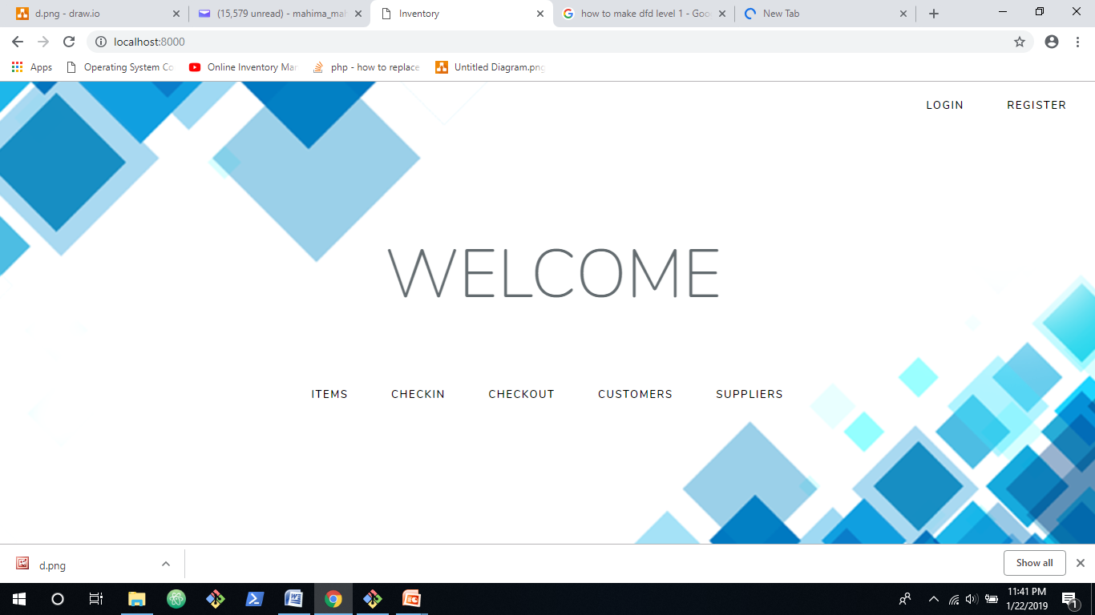
SCREENSHOTS

Slide 12
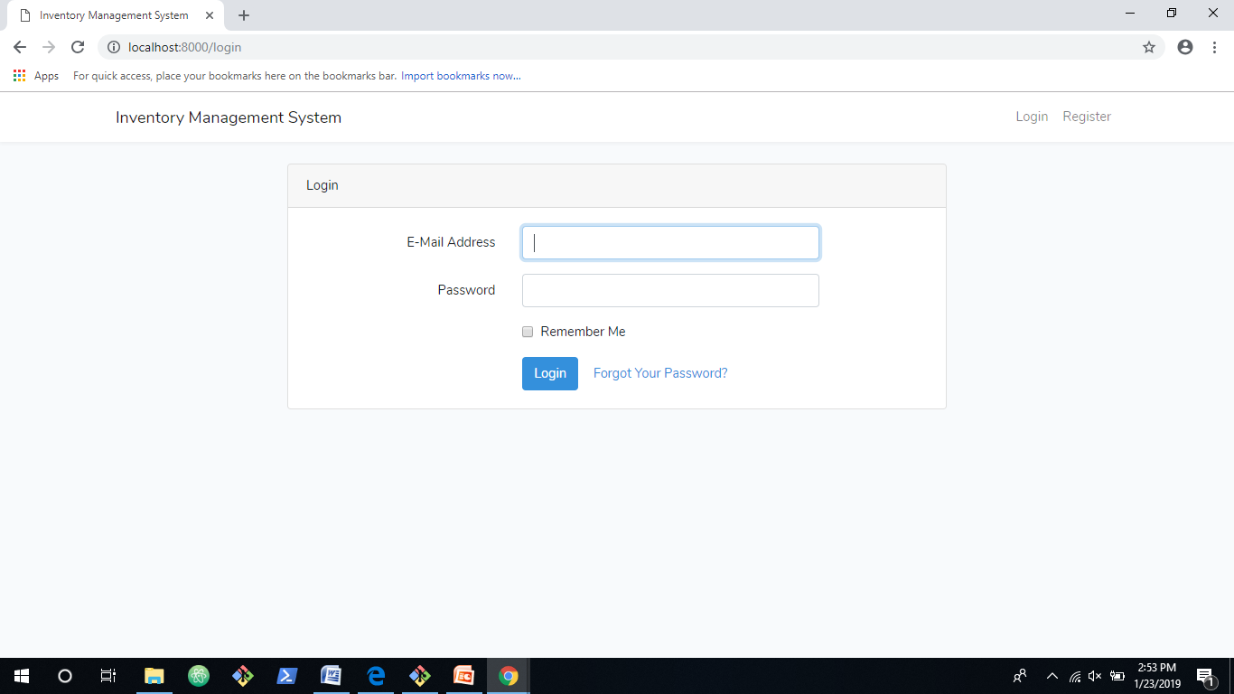

Slide 13
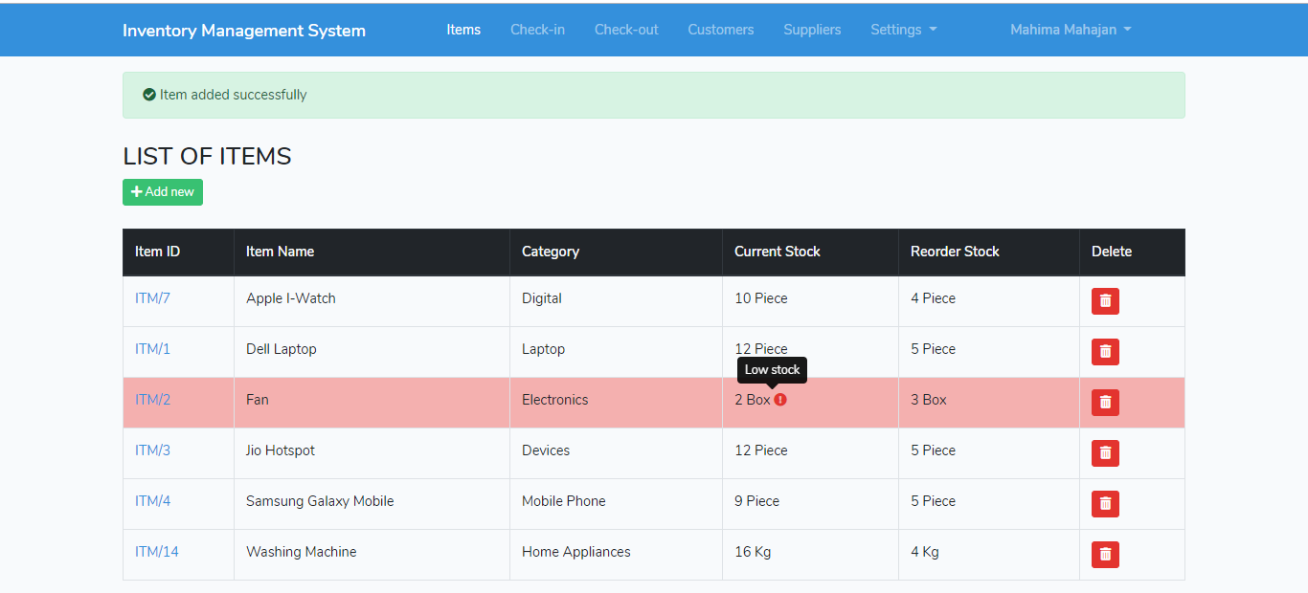

Slide 14
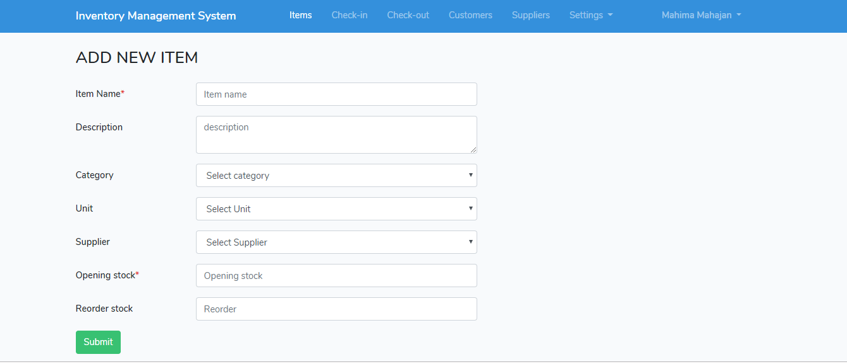

Slide 15
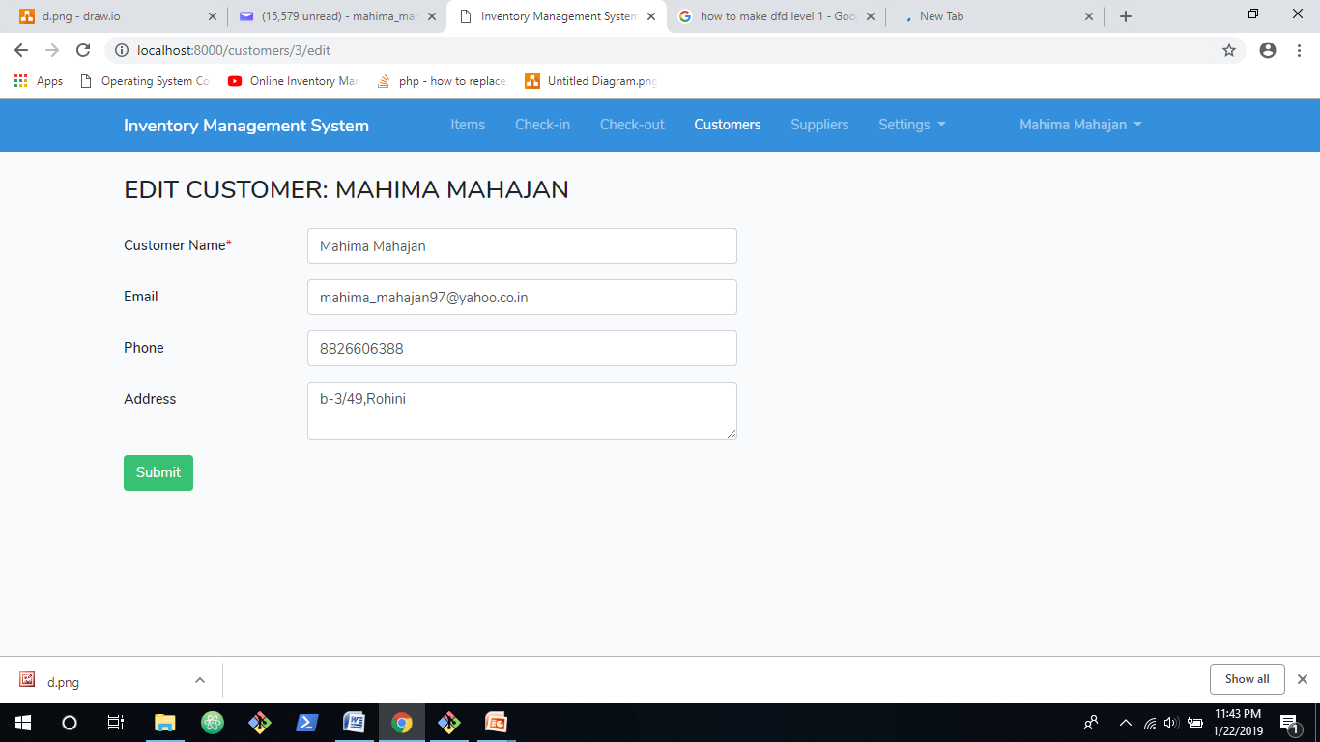

Slide 16
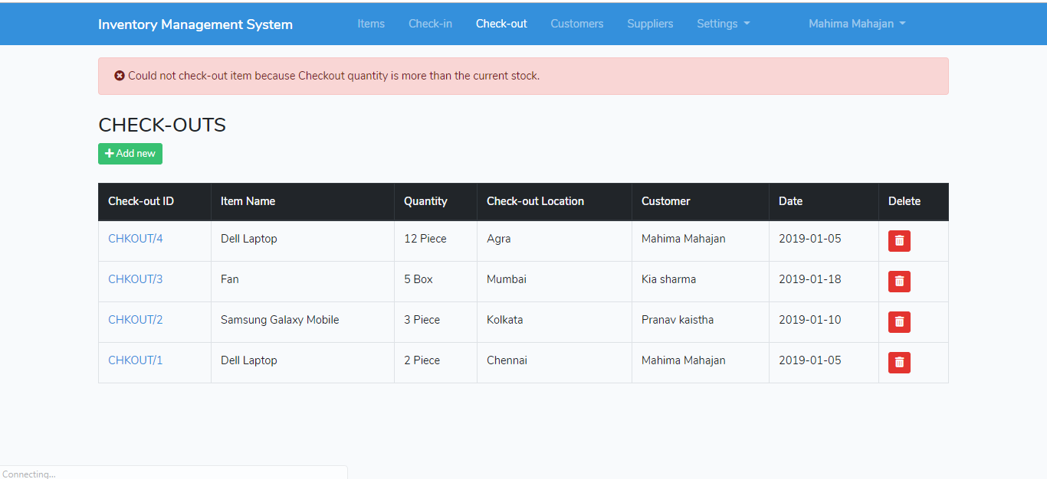

Slide 17
LIMITATIONS
No confirmation Box before deletion.
Will delete the record from the database on clicking delete button.

Slide 18
FUTURE SCOPE
Active/Inactive State
Invoice Generation
Bar-code Reader
Report Generation
Dead Stock alert

Slide 19
REFERENCES
https://getbootstrap.com/
https://www.tutorialspoint.com/laravel/
https://laravel.com/docs/5.1/quickstart
https://www.w3schools.com/booTsTrap/default.asp

Slide 20
THANK YOU!

